Slide 1
Python Practical Programming
Ch01: Introduction to Python Programming
Instructor: Yunbo Rao
E-mail: uestc2008@126.com
Tel: 15908177003
WeChat ID: waverao

Slide 2
Chapter 1 Introduction to Python Programming
Highlights of the chapter:
1.1 Programming languages
1.2 Python Language Overview
1.3 Python Language Versions and Development Environments
1.4 Executing Python Programs with Python Interpreter Interpretation
1.5 Writing and Executing Python Source Programs Using Text Editors and the Command Line

Slide 3
Chapter 1 Introduction to Python Programming
Highlights of the chapter:
1.6 Writing and Executing Python Source Programs Using the Integrated Development Environment IDLE
1.7 Packaging and distribution of programs
1.8 Online help and related resources

Slide 4
1.1 Programming languages
A computer system consists of hardware and software
Physical computers and peripherals are collectively referred to as hardware
The program that a computer executes is called software
Software is generally divided into two categories: system software and application software
A computer program specifies a series of steps required for a computer to complete a task
A programming language, also known as a programming language, is a set of syntax rules used to define a computer program. Each language has a unique syntax of keywords and program instructions

Slide 5
programming language
Programming languages are divided into two categories: low-level languages and high-level languages
Low-level languages are associated with specific machines
High-level languages are machine independent
Machine and assembly languages are low-level languages
Machine language is a first-generation programming language that uses binary code to write programs that are poorly readable but can be directly recognized and executed by computers
Assembly language is a second-generation programming language that uses simple mnemonics to represent instructions

Slide 6
programming language
High-level languages are languages that are independent of computer architecture, and their most important feature is that they describe the processing of a problem in a form similar to natural language.
C, C++, C#, Java and Python

Slide 7
Categorizing Programming Languages by Paradigm
process-oriented programming language
FORTRAN, COBOL, Basic, Ada, Pascal, C
object-oriented programming language
Java, C#, C++, Smalltalk, Visual Basic
functional programming language
Lisp, Scheme, Haskell, F#.
Logic-based programming language: Prolog
Python programming language is a multi-paradigm programming language

Slide 8
Computational thinking and programming methods
Human beings have developed the following three basic types of thinking in the process of recognizing the world and transforming it
Logical thinking: characterized by reasoning and deduction, represented by the subject of mathematics
Experimental thinking: characterized by experimentation and verification, represented by the discipline of physics
Computational thinking: characterized by design and construction, represented by the discipline of computing

Slide 9
Computational thinking and programming methods
The essence of computational thinking is Abstraction and Automation.
Programming methods belong to the realm of computational thinking, and there are two main types of programming methods that are commonly used
Structured and object-oriented programming

Slide 10
Programming methodology
Structured program design usually adopts a top-down (Top-Down), stepwise refinement (Stepwise Refinement) program design methodology
Basic Ideas of Top-Down Programming
Problem decomposition, algorithm implementation, combinatorial programs
Programs designed using the Top-Down approach are generally implemented via the Bottom-Up approach
Implementing, running and testing each of the basic functions first, and then testing the whole function made up of the basic functions, helps to locate errors

Slide 11
Preparation and execution of the program
Writing and editing programs in a text editor
Notepad, Vim, Emacs, Sublime, etc.
Specialized IDE development environments such as IDLE, Spyder, Visual Studio Code, etc.
After writing a program using a text editor, the file is saved to disk and the file containing the program code is called the source file.

Slide 12
Preparation and execution of the program
There are two conversion methods for converting source files into machine language as follows
Compile: The Compiler translates the source code into the target language.
Interpretation: Interpreter directly interprets and executes high-level programming language.

Slide 13
Classification of high-level programming languages according to execution mechanism
Static languages and scripting languages
Languages executed by compilation are static languages, such as C, C++, C#, Java, etc.
Advantages: compiled object code can be run directly; compiled object code is usually faster to execute
Languages that are executed in an interpreted manner are scripting languages, such as JavaScript, PHP, Python, etc.
Advantages: the source code can be run in an interpreter on any operating system, which makes it portable; the interpretation needs to retain the source code, so it is easy to correct errors and maintain the program.

Slide 14
1.2 Python Language Overview
English /ˈpaɪθən/, American /ˈpaɪθɑːn/
is an interpreted, object-oriented programming language
is an open source language with a large number of libraries for efficient development of various applications
Features of the Python language
Simple, high-level, object-oriented, extensible, free and open source, portable, rich library, embeddable
Python language applications
Operating Systems Administration, Scientific Computing, Web Applications, Graphical User Interface (GUI) Development, Other (Game Development, etc.)

Slide 15
1.3 Python Language Versions and Development Environments
2 major versions: Python 2 and Python 3
Python 3 was not designed with backward compatibility in mind
Python Language Implementation: Python Interpreter
Commonly used Python implementations:
Cpython, Jython, IronPython, PyPy
Integrated Development Environment for the Python Language
IDLE (built-in), Spyder, PyCharm, Eclipse + Pydev plugin, Visual Studio + Python Tools for Visual Studio, PythonWin

Slide 16
Downloading and installing Python
This book builds a Python development platform based on Windows 10 and Python 3.10
[Example 1.1] Downloading the Python Installer
https://www.python.org/downloads/windows/
Click the hyperlink Windows installer (64-bit) to download the installer python-3.10.1-amd64.exe for the latest version of Python 3.10 (64-bit) available today!

Slide 17
Downloading and installing Python
[Example 1.2] Installing a Python Application
(1) Double-click the downloaded Windows-formatted installation file python-3.10.1-amd64.exe
(2) In the Customize Python dialog window, note that you need to check the "Add python 3.10 to PATH" checkbox.
(3) Click on the Install Now hyperlink to install the Python program

Slide 18
Installing and managing Python extension packages
Python 3.4 onwards includes pip and setuptools libraries
pip is used to install and manage Python extensions.
setuptools for distributing Python packages
A typical application of pip is to install Python third-party packages from PyPI (Python Package Index)
[Example 1.3] Updating pip and setuptools packages
In a Windows command prompt window, enter the command line command "pip install -U pip setuptools" to update the pip and setuptools packages
[Example 1.4] Installing the NumPy Package
In a Windows command prompt window, enter the command line command "pip install NumPy" to install the NumPy package.
[Example 1.5] Installing the Matplotlib Package
In a Windows command prompt window, enter the command line command "pip install Matplotlib" to install the Matplotlib package.

Slide 19
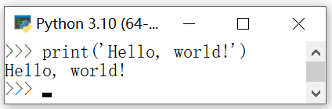
1.4 Interpreting and executing Python programs using the Python interpreter (1)
The default installation path for Python is ...AppData\Local\Programs\Python\Python310\, which includes
Python interpreter python.exe
Python library directory and other files
[Example 1.6] Running the Python Interpreter
"Start"|"All Apps"|Python 3.10|Python 3.10(64-bit)
[Example 1.7] Output Hello world!
The prompt for the Python interpreter is: >>>>
>>> print('Hello, world!')

Slide 20
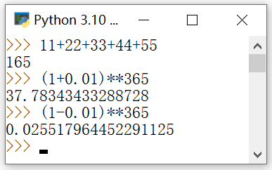
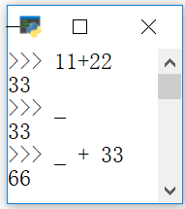

Interpreting and executing Python programs using the Python interpreter (2)
[Example 1.8] Using the Python Interpreter for Mathematical Operations
>>> 11+22+33+44+55 # Output: 165
>>> (1+0.01)**365
>>> (1-0.01)**365
[Example 1.9] Using special variables in the interpreter environment: _
>>> 11+22 # Output: 33
>>> _ # Output: 33
>>> _ + 33 # Output: 66
[Example 1.10] Running multiple expressions at the same time: Run multiple comma-separated expressions at the same time and return the result as a tuple
>>> 2,2**10 # Output: (2, 1024)
[Example 1.11] Turning off the Python interpreter
Ctrl+Z and Enter; or type the quit() command; or just close the command line window

Slide 21
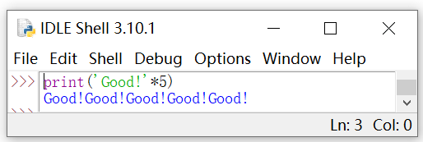
Running the Python Integrated Development Environment IDLE (1)
Example 1.12] Running Python's Built-in Integrated Development Environment IDLE
"Start | All Apps | Python 3.10 | IDLE (Python 3.10 64-bit)
Example 1.13] Using IDLE to Interpret and Execute Python Statements
>>> print('Good!'*5)
Good!Good!Good!Good!Good!

Slide 22
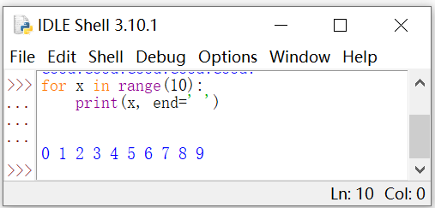
Running the Python Integrated Development Environment IDLE (2)
[Example 1.14] Using IDLE to Execute Multiple Lines of Code
Prints numbers in the range 0 through 9 separated by spaces
>>> for x in range(10):
print(x, end=' ')
[Example 1.15] Closing IDLE
You can close the Python interpreter by typing the command quit() or by closing the IDLE window.

Slide 23
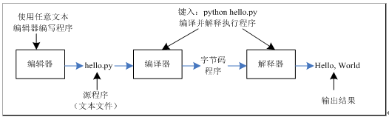
1.5 Writing and executing Python source file programs using a text editor and command line (1)
Writing a Python program as a text file (.py)
The process of writing a Python source file program and executing it through the Python compiler/interpreter.

Slide 24
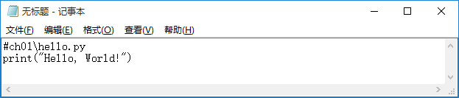
1.5 Writing and executing Python source file programs using a text editor and command line (2)
[Example 1.16] Writing a Hello world program using a text editor (Notepad)
In Notepad, enter the program source code. Save the file as hello.py.
Note that for "Save as type" select "All files" and for "Encoding" select UTF-8.
Hello world program (hello.py) source code analysis
The first line is a comment. Start with the symbol # and end at the end of the line
Line 2 calls the built-in library function print with the output: Hello, World!

Slide 25
1.5 Writing and executing Python source file programs using a text editor and command line
[Example 1.17] Running hello.py in a Windows Command Prompt Window
(1) Execute "Start" | "All Applications" | "Windows System" | "Command Prompt ", open the Windows Command Prompt window
(2) Enter the command line command "python c:\pythonpa\ch01\hello.py", press enter to execute the program
(3) Enter the command line command "c:\pythonpa\ch01\hello.py", press enter to execute the program
(4) Enter "cd c:\pythonpa\ch01", enter the command line command "python hello.py", press the Enter key to execute the program.
(5) Switch to the working directory "c:\pythonpa\ch01", then enter the command line command "hello.py", press the Enter key to execute the program.

Slide 26
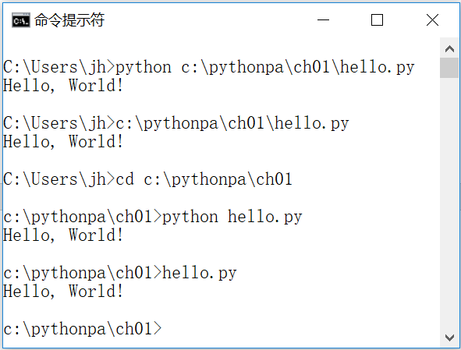
1.5 Writing and executing Python source file programs using a text editor and command line

Slide 27
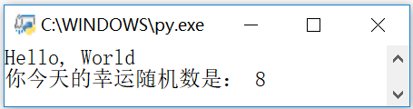
1.5 Writing and executing Python source file programs using a text editor and command line
[Example 1.18] Using Explorer to Run hello1.py
(1) The contents of the program hello1.py are as follows:
import random #Import library module
print("Hello, World") #Output: Hello, World
print("Your lucky random number today is:", random.choice(range(10))) #Output a randomly chosen number from 0 to 9
input() #Wait for user input

Slide 28
1.5 Writing and executing Python source file programs using a text editor and command line
(2) In Explorer, double-click the hello1.py file in the c:\pythonpa\ch01 directory to execute the hello1.py source program
(3) The meaning of each line of code in the program hello1.py is as follows:
The first line of code imports the library module random. python can import and use feature-rich standard or extended libraries.
The second line of code calls the built-in library function print() to output "Hello, World".
The third line of code uses the random library's choice function to randomly select a number in the range 0 to 9 and output it.
The fourth line of code calls the built-in library function input(). The user presses Enter and the program ends its run

Slide 29

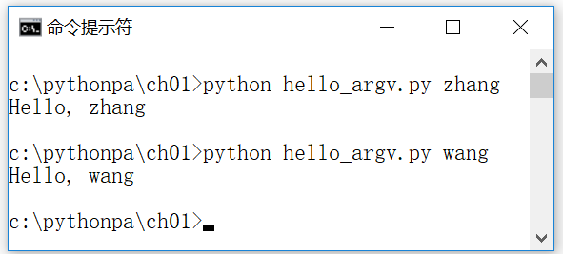
1.5 Writing and executing Python source file programs using a text editor and command line (1)
[Example 1.19] Example of command line arguments (hello_argv.py)
The contents of hello_argv.py are as follows:
import sys
print('Hello, ' + sys.argv[1])
Program run results:

Slide 30
1.6 Write and execute Python source file programs using the Integrated Development Environment IDLE
[Example 1.20] Writing a program to solve for the 1024th power of 2 using IDLE (bigint.py)
(1) "Start" | "All Apps" | Python 3.10 | IDLE (Python 3.10 64-bit), open the built-in IDE IDLE
(2) Execute the IDLE menu command File | New File (or press the shortcut key Ctrl + N), the new Python source code file
(3) Enter the program source code in the Python source code editor: print("2 to the 1024th power:", 2**1024)
(4) Execute the IDLE menu command File|Save (or press the shortcut key Ctrl+S) to save the file as bigint.py.
(5) Execute the IDLE menu command Run|Run Module (or press the shortcut key F5), and output the results of running the program.
[Example 1.21] Editing the hello1.py Program with IDLE

Slide 31
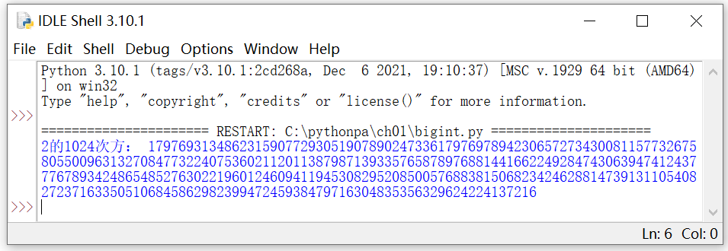

1.6 Write and execute Python source file programs using the Integrated Development Environment IDLE
import random #Import library module
print("Good Luck!") #Output: Good Luck!
print("Your lucky random number today is:", random.choice(range(10))) #Output a randomly chosen number from 0 to 9
input() #Wait for user input

Slide 32
1.7 Packaging and distribution of programs
Python programs are most commonly packaged and distributed with the third-party extension package PyInstaller, which is used to generate Python source programs into directly runnable programs.
[Example 1.22] Installing the PyInstaller Package
In a Windows command prompt window, enter the command line command "pip install pyinstaller" to install the PyInstaller package
Generating Executable Programs with PyInstaller
pyinstaller Options Python Source Files
[Example 1.23] Using PyInstaller to Generate Executable Files
(1) Open a Windows command line window. In a Windows command prompt window, switch to the C:\pythonpa\ch01 directory.
(2) Generate an executable file. Enter the command line command "pyinstaller -F hello1.py" to generate the executable file.
(3) Run the executable file. Switch to the C:\pythonpa\ch01\dist directory, type "hello1.exe", press Enter to execute the program, and observe the result.

Slide 33
1.8 Online help and related resources (1)
Python Interactive Help System
Type the help() function directly to access the interactive help system.
Type help(object) to get help information about an object.
[Example 1.24] Using the Python Interactive Help System Example
(1) Access the interactive help system. In the Python interpreter, type help(), press enter
(2) Display all installed modules. Type modules, then press enter.
(3) Display the modules associated with random. Type modules random and press enter
(4) Display help information for the module random. Type random and press enter.
(5) Display information about the random function of the random module. Type random.random, then press the Enter key
(6) Exit the help system. Type quit, then press enter.

Slide 34
1.8 Online help and related resources (2)
[Example 1.25] Using Python's Built-in Functions to Get Help Information
(1) View the list of Python built-in objects. Enter the command: >>>> dir(__builtins__)
(2) View information about float. Enter the command: >>> float
(3) Check the help information of the built-in class float. Enter the help(float) command.
Python Documentation: Detailed reference information on the Python language and standard modules.
[Example 1.26] Using Python Documentation
(1) Open the Python documentation. Execute the Windows menu command "Start" | "All Applications" | Python 3.10 | Python 3.10 Manuals (64-bit) (Users can also press the F1 key in the IDLE environment) to open the Python documentation
(2) Browse the random module help information. Expand the catalog tree on the left to browse the random module's help information.
(3) Find help information about math. Click on the Search tab on the left, type math, then press Enter and double-click in the directory tree on the left to see help on math.

Slide 35
1.8 Online help and related resources (3)
Python official website: https://www.python.org/
Users can download various versions of Python programs or view help files, etc.
Python Extended Library Index (PyPI): https://pypi.python.org/
Everyone can download third-party libraries or upload their own libraries to PyPI. pyPI recommends using the pip package manager to download third-party libraries.

Slide 36
PEP
Python Enhancement Proposals (Python Enhancement Proposals, also translated as Python Improvement Proposals)
PEP's official website is https://www.python.org/dev/peps/
A PEP is usually a formal document that summarizes information from multiple sources and is reviewed and approved by some of the core developers.

Slide 37
PEP
[Example 1.27] PEP-0008: Python Coding Specification
The official website for PEP-0008 is https://www.python.org/dev/peps/pep-0008/
Users can learn about Python programming specifications
[Example 1.28] PEP-0020: The Zen of Python
The official website for PEP-0020 is https://www.python.org/dev/peps/pep-0020/
Users can understand the guidelines for Python programming
Typing import this in the Python interpreter also outputs "The Zen of Python" as follows

Slide 38
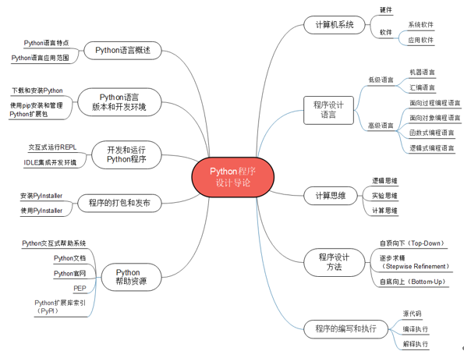
Summary of the chapter

Slide 39
Case Study 1: Installing and Using Other Python Environments
The main objective of this chapter's case study is to help students learn and research using other Python development environments through the installation and use of Anaconda
Anaconda's official website can be downloaded at https://www.anaconda.com/download/
The current installer for the latest version of the Windows version, Anaconda3-2021.11-Windows-x86_64.exe
Double-click Anaconda3-2021.11-Windows-x86_64.exe to install the Anaconda application
Installing Anaconda is equivalent to installing Python, IPython, the IDE Spyder, and a few common scientific computing packages
The solution and source code etc. of the case studies are provided in electronic format, please scan the QR code in the tutorial for details

Slide 40
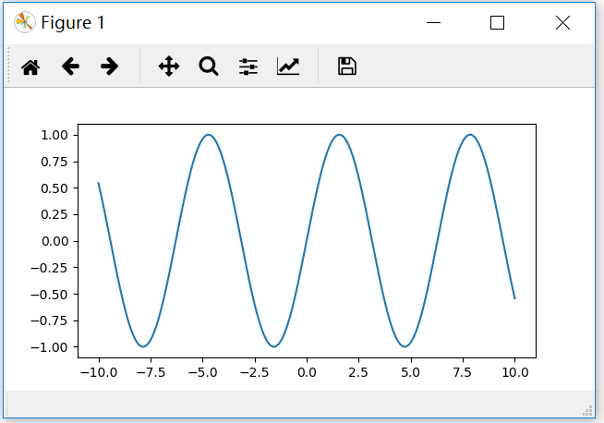
Case Study 1: Installing and Using Other Python Environments
Example CS1A.4: IPython Magic Function Usage Examples
Quickly measure code runtime with the %timeit command
In [6]: %timeit sum(range(1000000))
Run the script using the %run command
In [7]: %run c:\pythonpa\ch01\bigint.py
Interactive calculations using %pylab
In [8]: %pylab
In [9]: x=linespace(-10,10,1000)
In [10]: plot(x, sin(x))
Figure CS-13 Dynamic Plotting Results on the Console Using %pylab

Slide 41
Case Study 2: Installing and Using the PyCharm Development Environment
Use of the Python interpreter, IDLE, or Anaconda can fulfill the requirements for learning Python or using Python for scientific research
If you need to use Python for project development, it is recommended to use a professional IDE.
The main objective of the case study in this chapter is to help students with Python project development using the PyCharm IDE through the installation and use of PyCharm
This case study will describe the installation and use of PyCharm Professional Edition
The solution and source code etc. of the case studies are provided in electronic format, please scan the QR code in the tutorial for details

Slide 42
Installing PyCharm with the JetBrains Toolbox App
JetBrains recommends using the JetBrains Toolbox App to install JetBrains products. Use the JetBrains Toolbox App to install and manage different products or multiple versions of the same product, including Early Access Program (EAP) and Nightly versions.The JetBrains Toolbox App maintains a list of all the projects so that you can quickly open a project in the correct IDE version!
After downloading and installing the Toolbox App (e.g. jetbrains-toolbox-1.24.12080.exe) from the Toolbox App web page (https://www.jetbrains.com/toolbox/app/), run the Toolbox application, which will open a window as shown in Figure CS1B- 1, click on the icon in the notification area and select the product and version to be installed.
Logging in to the user's JetBrains account from the Toolbox application will automatically activate any IDE licenses available for the user's installation

Slide 43
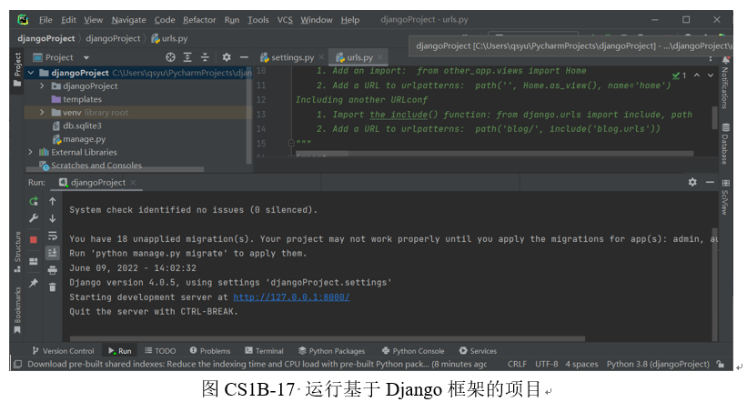
Installation and usage of PyCharm Professional Edition
[Example CS1B.1] Downloading and Installing PyCharm Professional Edition
[Example CS1B.2] Creating a PyCharm Project
[Example CS1B.3] Creating a PyCharm Project Based on the Django Framework

Slide 44
Thank!

